Slide 1
Welcome to
We will begin shortly
www.foodhandler.com

Slide 2
Food Safety Best Practices:
Kitchen Management and Food Storage
Cyndie Story, PhD, RD, CC, SNS
Jeannie Sneed, PhD, RD, CP-FS

Slide 3
Goals for Today
Identify Kitchen Management (KM) techniques that support food safety
Identify food storage best practices that can improve food safety and quality
Assess food safety practices currently in use and determine improvements

Slide 4
KM: Planning
Cycle Menu
Standardized Recipes
Product Solicitation (Bids)
Equipment
Staff Education
Notes:
Length of cycle menu is typically driven by the number of lines and choices provided daily. For example, a school with 6 serving lines may have a cycle menu of 1 to 2 weeks, whereas a school with 2 serving lines may cycle every 4 weeks. I will have much to say about recipes, bids, equipment and staff education…..

Slide 5
KM: Implementing
Work Schedules
Communicates expectations
Includes kitchen specifics
Equipment
Space
Product form
Food safety
Work Plans
Efficient inputs = less tired staff = better morale + improved productivity!

Slide 6
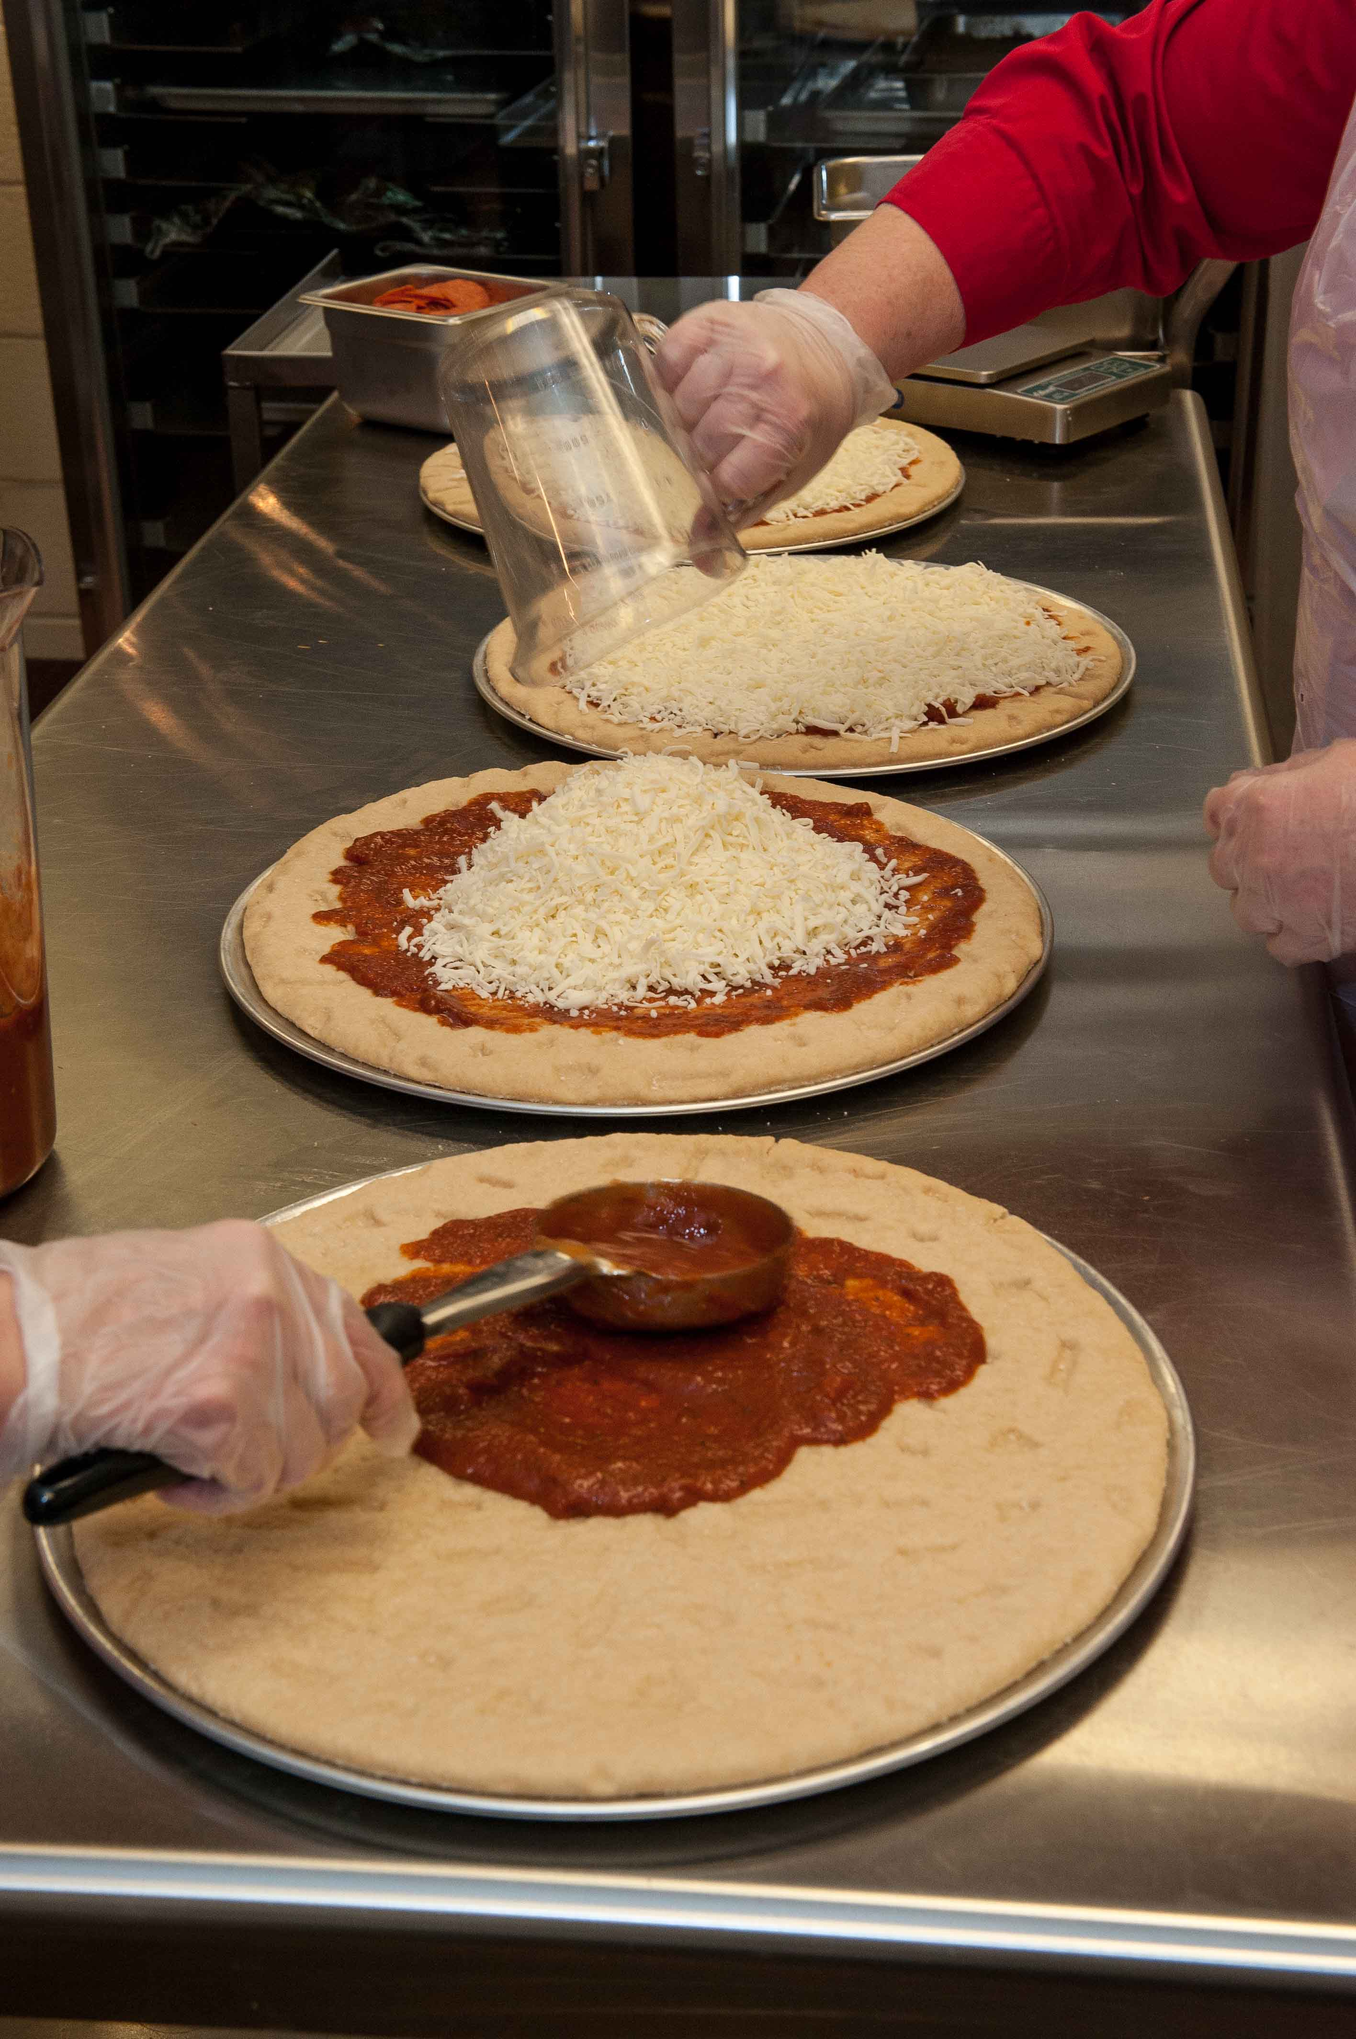
KM: Evaluating
Continuous feedback
Staff
Customer
Staff works as a team
Tasks completed on time
Establish time standards
Review/conduct checklist(s)
Safety
Quality
Notes:
Kitchen management should be evaluated daily through continuous feedback. Managers often comment they love the job because it is never boring.

Slide 7
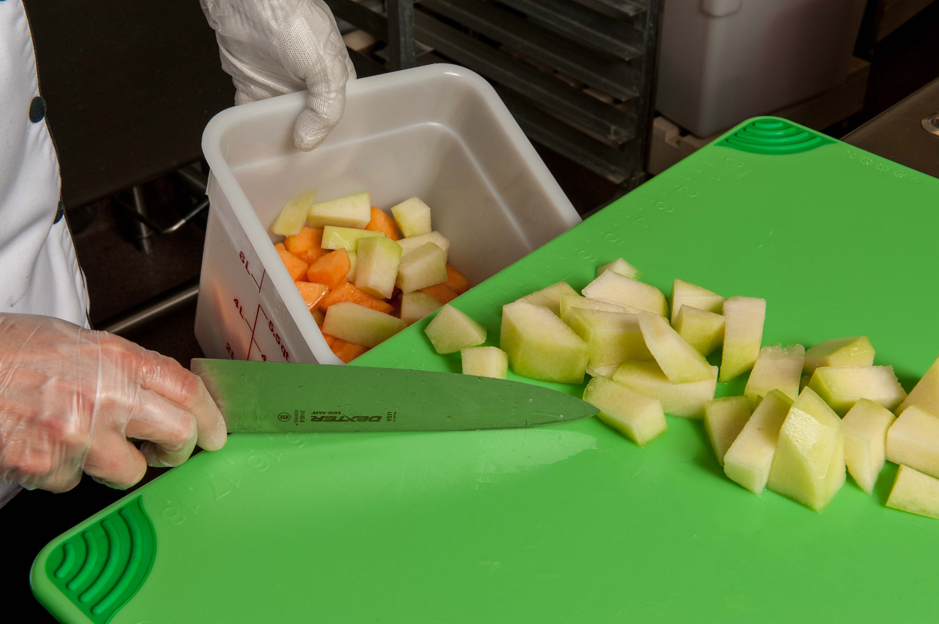
Food Storage Goals
Maintain food quality
Ensure food safety
Control cost
Notes:
Food storage is an important part of good kitchen management. There are three main goals related to food storage. The first goal is to maintain food quality. We want to serve the best quality food possible, and we know that some products lose quality over time. Think about lettuce. When it is fresh and green, it is great to eat. When it becomes brown and limp—not so much! The second goal of food storage is to ensure the safety of the food served.

Slide 8
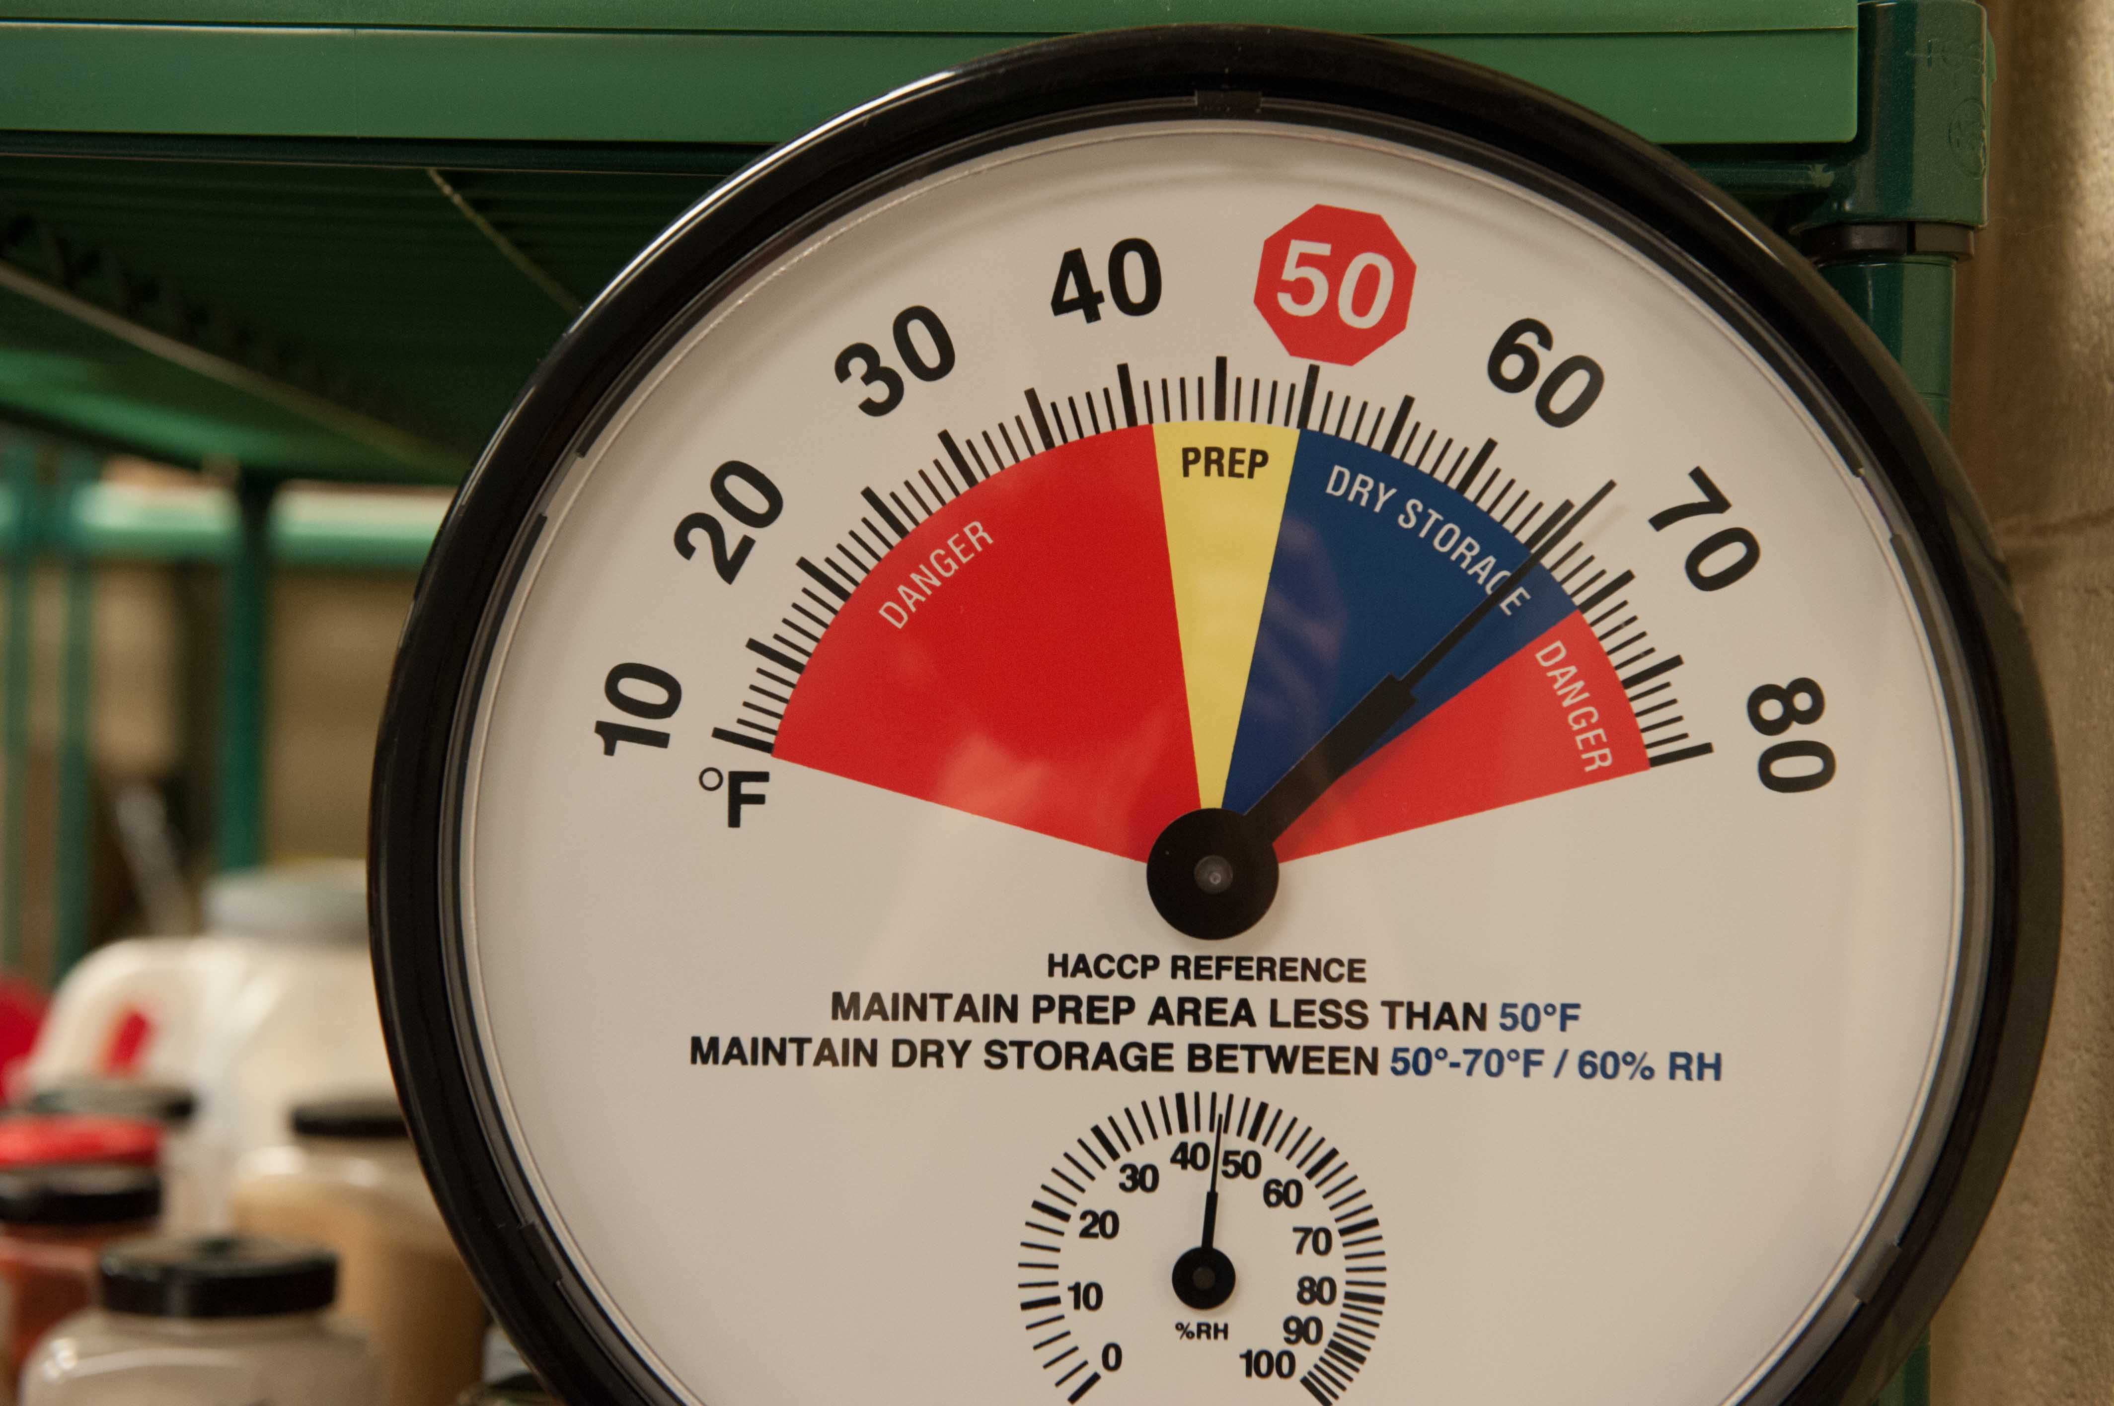
Storage Temperatures
Dry Storage—50-70ºF
Refrigerated Storage—less than 41ºF
Freezer Storage—0ºF or less

Slide 9
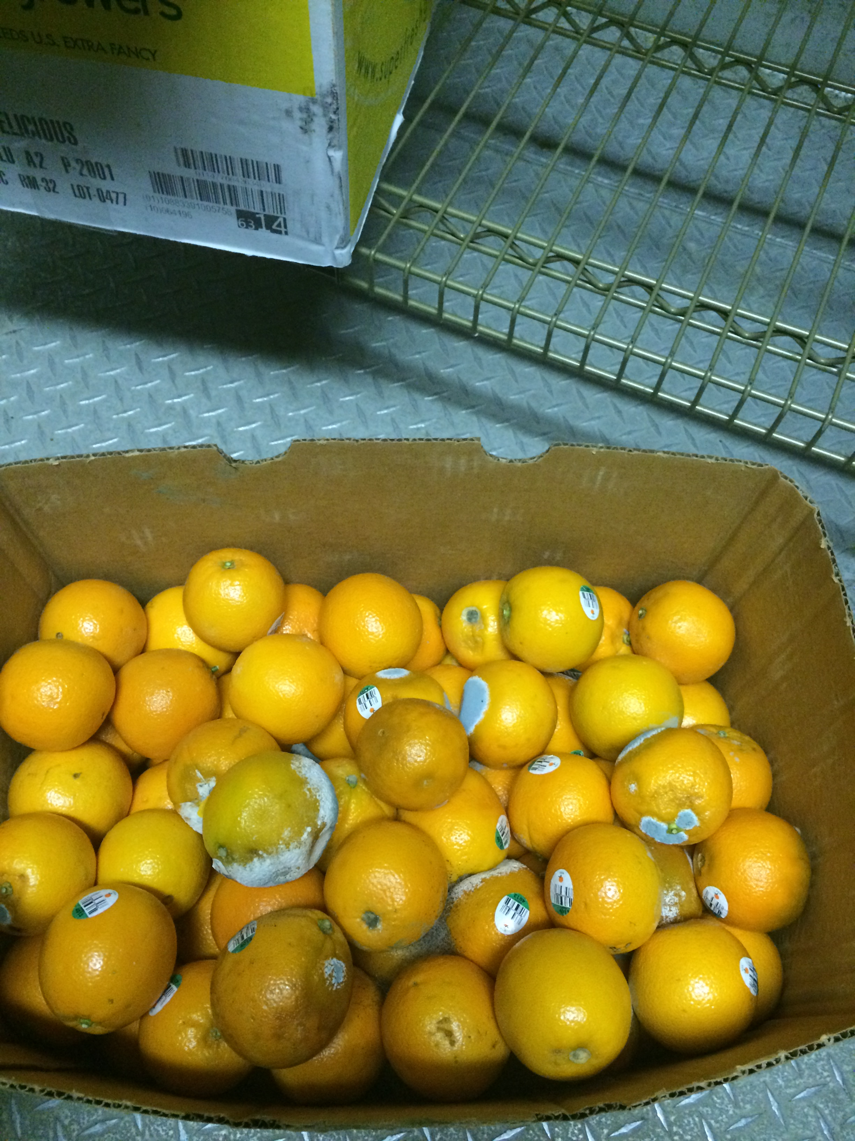
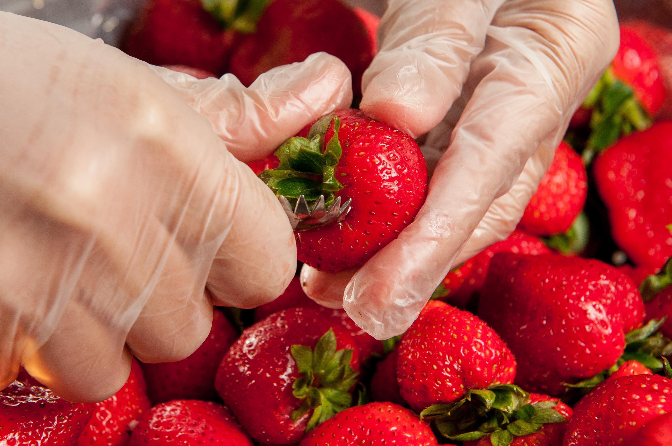
Inventory Rotation
First In, First Out
First Expired, First Out
Inventory Turnover

Slide 10
Food Dates
Sell by Date
Best if used by Date
Use-By Date
Closed or Coded Dates
Notes:
The dates used on foods can be very confusing. There are sell by dates, best if used by dates, use-by dates, and closed or coded dates. It is challenging to sort out the meaning of these dates, especially when food seems to be fine past those dates. There is no uniform system of dating foods in the U.S. and requirements for specific foods can vary by state. And, it can create a lot of food waste and increased costs if we automatically toss out food when one of those dates is near or slightly passed. Further, for time/temperature control for safety foods, the date when the product is good often depends on how well the cold chain was managed. You might open a product that is well within the dates that it is supposed to be good and find that it is spoiled. That is an indication that it was temperature abused. So, let’s talk about what each of these terms means so that you can make better decisions about when to use food.

Slide 11
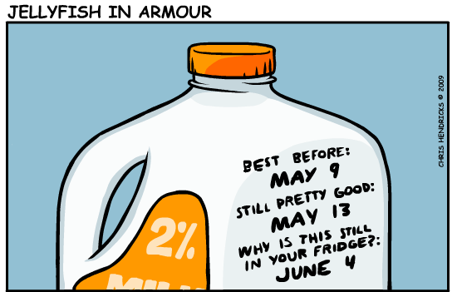
Food Dates
Sell-By Date—this is the date that guides stores or distributors on how long to display or sell the product.
Notes:
Some humor.

Slide 12
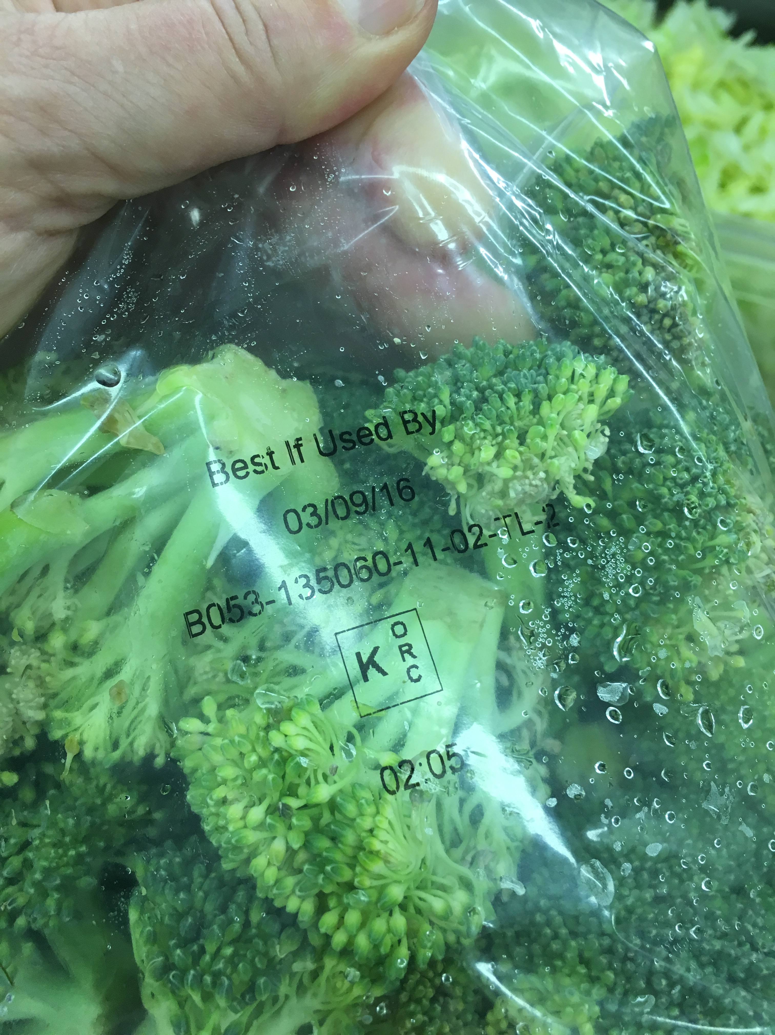
Food Dates
Best if used by—this is the date recommended for the best quality and flavor for a product. It is NOT a purchase or food safety date.

Slide 13
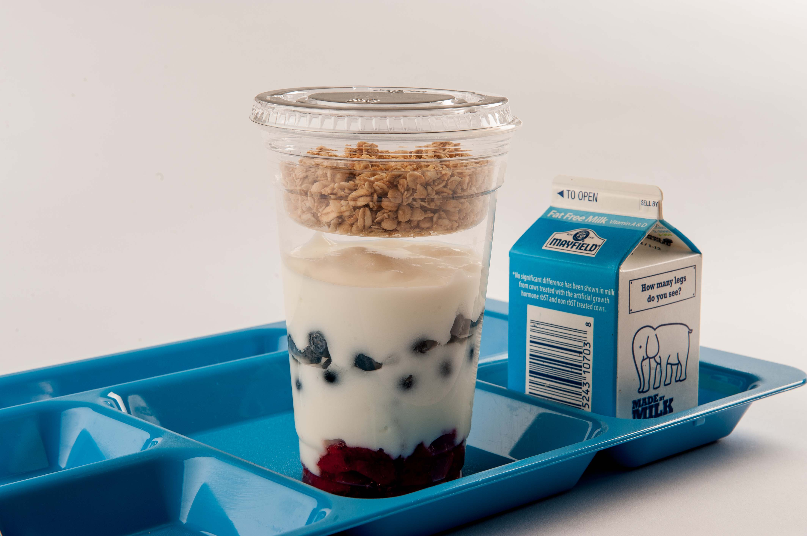
Food Dates
Use-by date—this is the last date recommended for use of a product at its peak quality. This date is determined by the manufacturer.

Slide 14
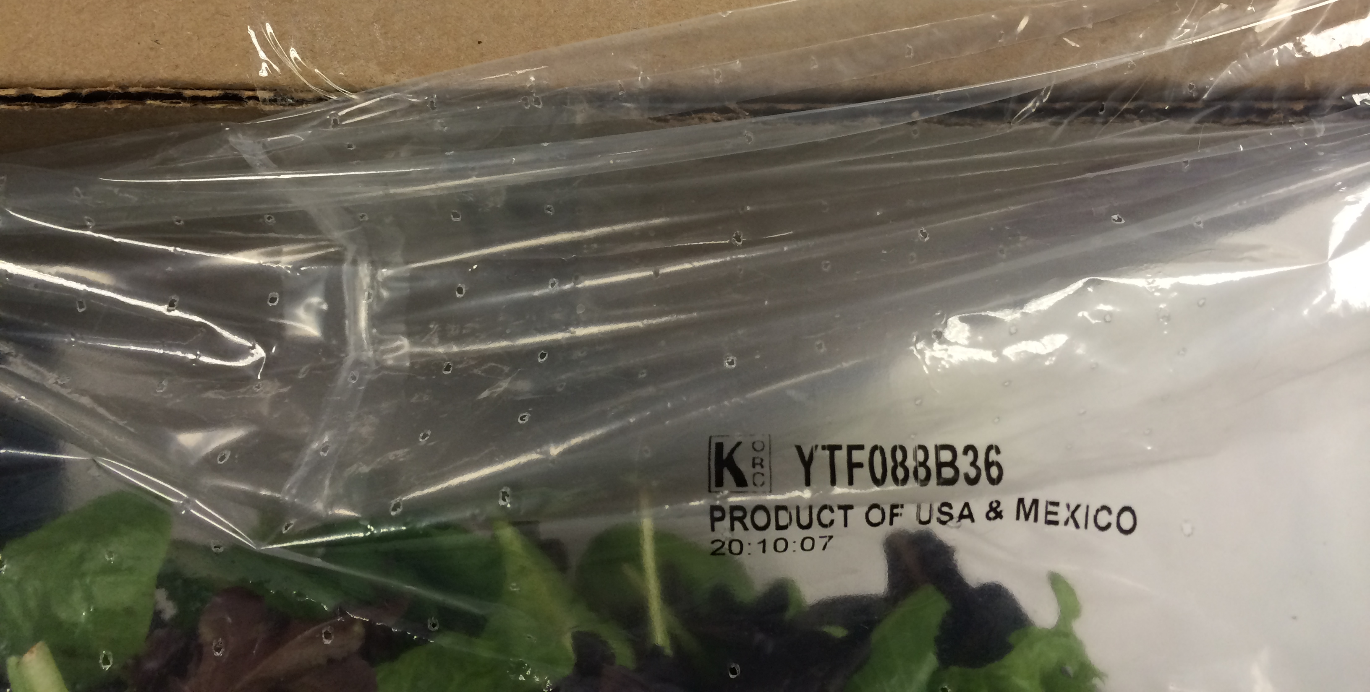
Food Dates
Closed or coded dates—these are packing numbers used by the manufacturer.
Notes:
Closed or coded dates are those dates used by the manufacturer to identify when a product was processed. These dates are most likely to appear on shelf-stable products such as canned goods or dry, boxed products. Dating by manufacturers help them to rotate their stock in a timely manner and it locate their products if there were a food recall. Canned foods are safe almost indefinitely as long as they have not been exposed to very low or very high temperatures and as long as the cans are not dented, rusted, or swollen. The type of food also impacts how long it is of good quality. For example, high acid foods such as canned tomatoes are of the best quality if kept for 12-18 months while low-acid foods such as canned meats and vegetables will be good for 2-5 years. Now, we are not recommending that you keep foods for that long. We encourage you to rotate your stock and turnover your inventory to ensure the best quality and safety. But, it does point out to you that just because a can says “best if used by 12/2016” doesn’t mean that you automatically have to discard it then if it has not been used.

Slide 15
Storage Times
Refrigerator Storage of Fresh or Uncooked Products
Product | Storage Times After Purchase
Poultry | 1 or 2 days
Beef, Veal, Pork and Lamb | 3 to 5 days
Ground Meat and Ground Poultry | 1 or 2 days
Fresh Variety Meats (such as liver) | 1 or 2 days
Cured Ham, Cook-Before-Eating | 5 to 7 days
Sausage from Pork, Beef or Turkey, Uncooked | 1 or 2 days
Eggs | 3 to 5 weeks
Notes:
Here is a chart published by USDA Food Safety and Inspection Service that provides guidelines for the length of time that fresh or uncooked foods should be sored in the refrigerator before use. There is quite a large range of times—from 1-2 days for poultry and ground meats to three to five weeks for eggs. Depending on how often you receive deliveries and whether your purchase products fresh or frozen, you may need to adjust your menu to make sure that you use products within the recommended times.

Slide 16
Storage Times
Refrigerator Storage of Processed Products Sealed at Plant
Processed Product | Unopened, After Purchase | After Opening
Cooked Poultry | 3 to 4 days | 3 to 4 days
Cooked Sausage | 3 to 4 days | 3 to 4 days
Sausage, Hard/Dry, shelf-stable | 6 weeks/pantry | 3 weeks
Corned Beef, uncooked, in pouch with pickling juices | 5 to 7 days | 3 to 4 days
Vacuum-packed Dinners, Commercial Brand with USDA seal | 2 weeks | 3 to 4 days
Bacon | 2 weeks | 7 days
Hot dogs | 2 weeks | 1 week
Luncheon meat | 2 weeks | 3 to 5 days
Ham, fully cooked | 7 days | slices, 3 days; whole, 7 days
Ham, canned, labeled "keep refrigerated" | 9 months | 3 to 4 days
Ham, canned, shelf stable | 2 years/pantry | 3 to 5 days
Canned Meat and Poultry, shelf stable | 2 to 5 years/pantry | 3 to 4 days
Notes:
USDA also provides recommended refrigerator storage times for processed foods. Notice that these times are far longer than the times for the fresh or unprocessed foods. Even though the times are longer, it is important to monitor your inventory and make sure that you use the oldest products first. If you find that you have too much products in inventory, you may want to adjust your purchasing quantities.

Slide 17
Prevent Cross Contamination
Separate raw animal food from:
Raw ready-to-eat foods
Cooked ready-to-eat foods
Separate types of raw animal foods
Separate animal products from produce
Separate produce before washing from ready-to-eat produce

Slide 18
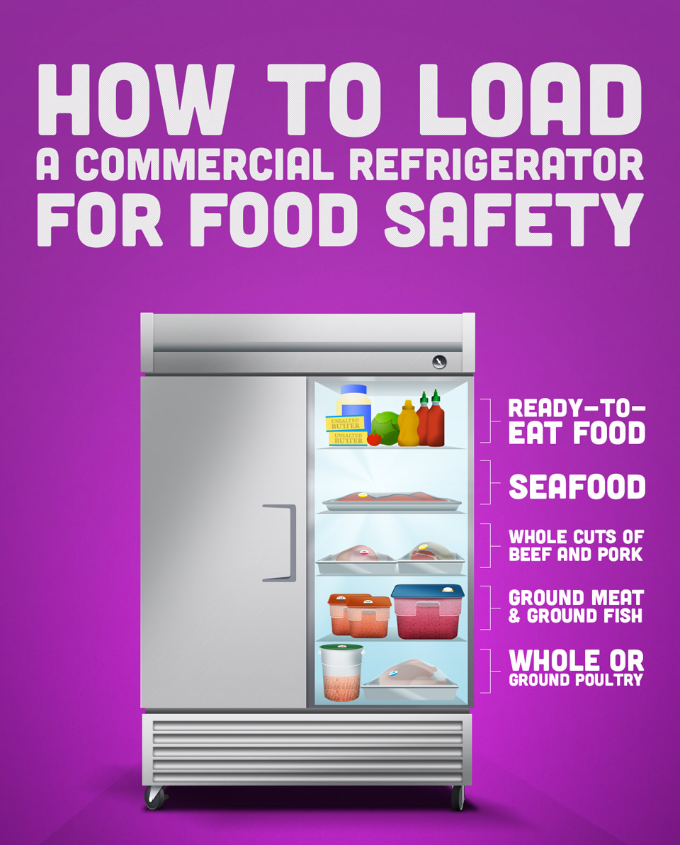
Cooler Organization

Slide 19
Cooler Organization

Slide 20
Storage
Keep foods in original containers OR Label containers with product’s common name
Use date marking
Use method approved by regulatory authority
Mark date of preparation and last day food can be served
Use calendar days, days of the week, color-coded marks or other effective method

Slide 21
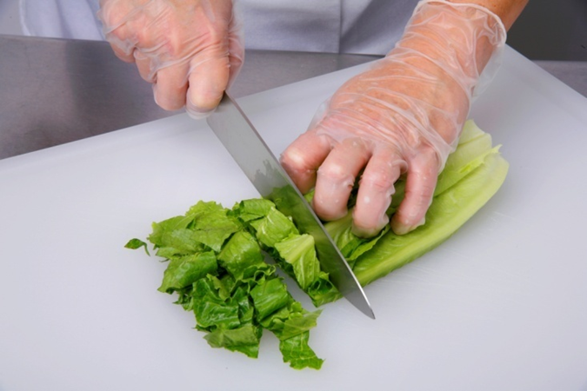
Improvements
Personal hygiene
Cross Contamination
Time and temperature control

Slide 22
Questions?
Cyndie Story, PhD, RD, CC, SNS
chefcyndiephd@gmail.com
Jeannie Sneed, PhD, RD, CP-FS
Jeannie@jeanniesneed.com

